Slide 1
CDE Advisor Setup & Manual
Semantic Similarity Matching
Presentation to Data Delivery
18.01.24

Slide 2
Setup
2

Slide 3
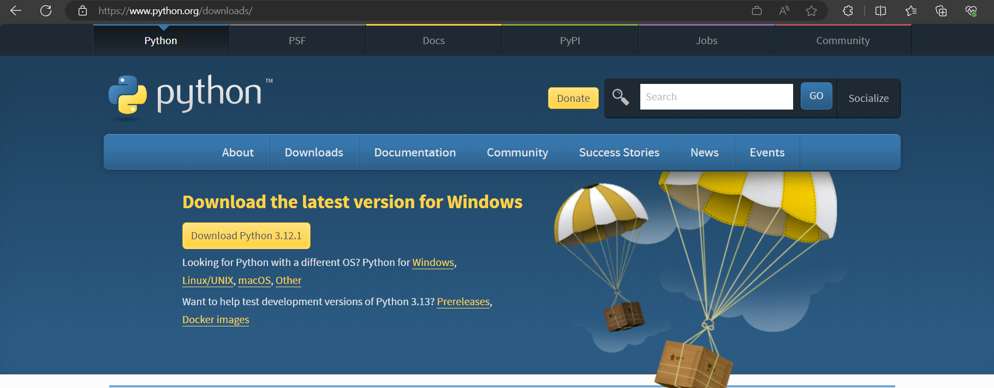
CDE Advisor Setup
Step 1: Download Python
Download Python | Python.org
Python download and installation depends if the user had Python installed in their local device.

Slide 4
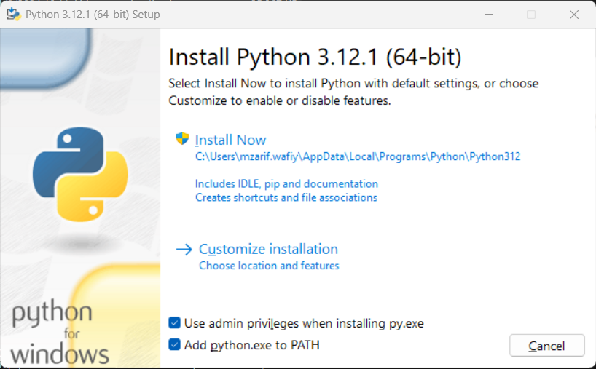
CDE Advisor Setup
Step 2: Run Python Installer
Click ‘Install Now’ and check ‘Add python.exe to PATH’

Slide 5
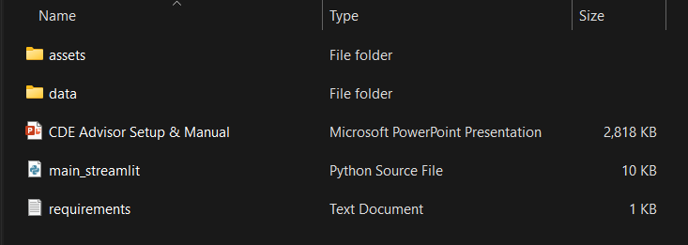
CDE Advisor Setup
Step 3: Download and unzip CDE Advisor folder

Slide 6
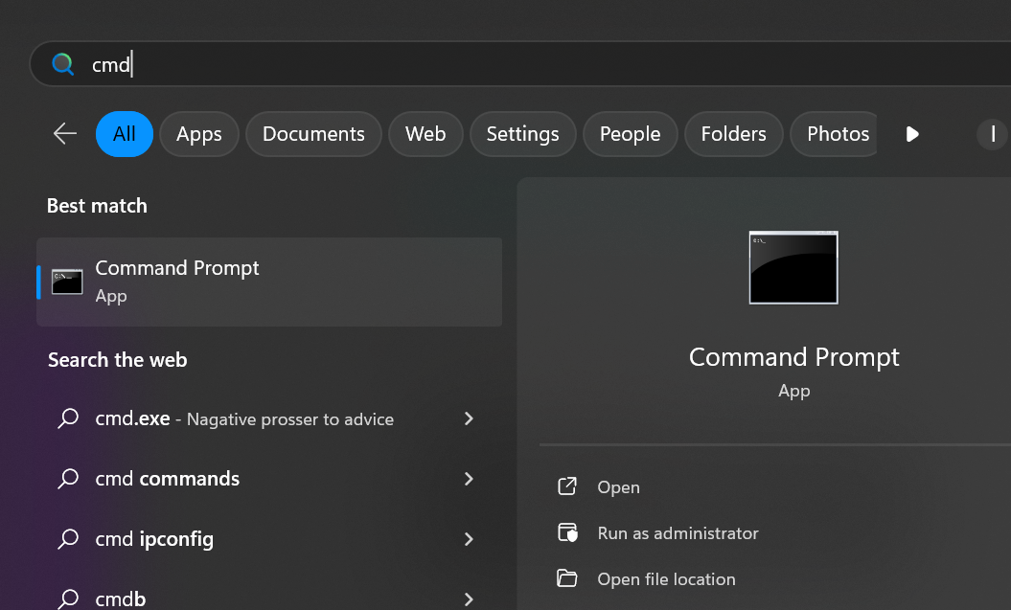
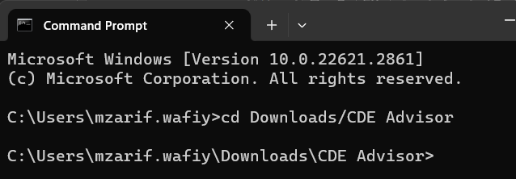
CDE Advisor Setup
Step 4: Open command prompt and navigate to CDE Advisor folder
> cd “Downloads/CDE Advisor”
Downloads would be the directory that resides the CDE Advisor folder. Change if necessary.

Slide 7
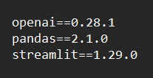
CDE Advisor Setup
Step 5: Install dependencies
> pip install –r requirements.txt
requirements.txt contains the libraries with the corresponding version of the program

Slide 8
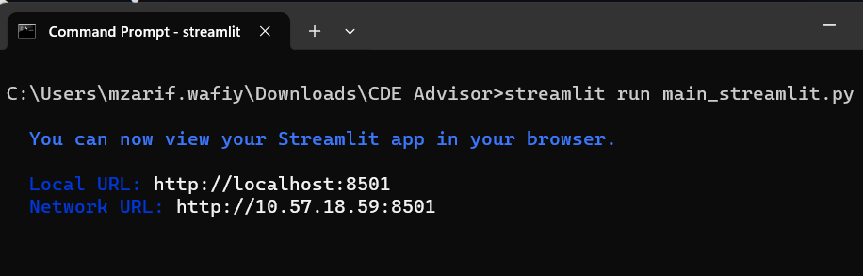
CDE Advisor Setup
Step 6: Run Python script, ‘main_streamlit.py’
> streamlit run main_streamlit.py
The streamlit app will be opened in user’s local device through the device’s default browser.

Slide 9
Manual
9

Slide 10
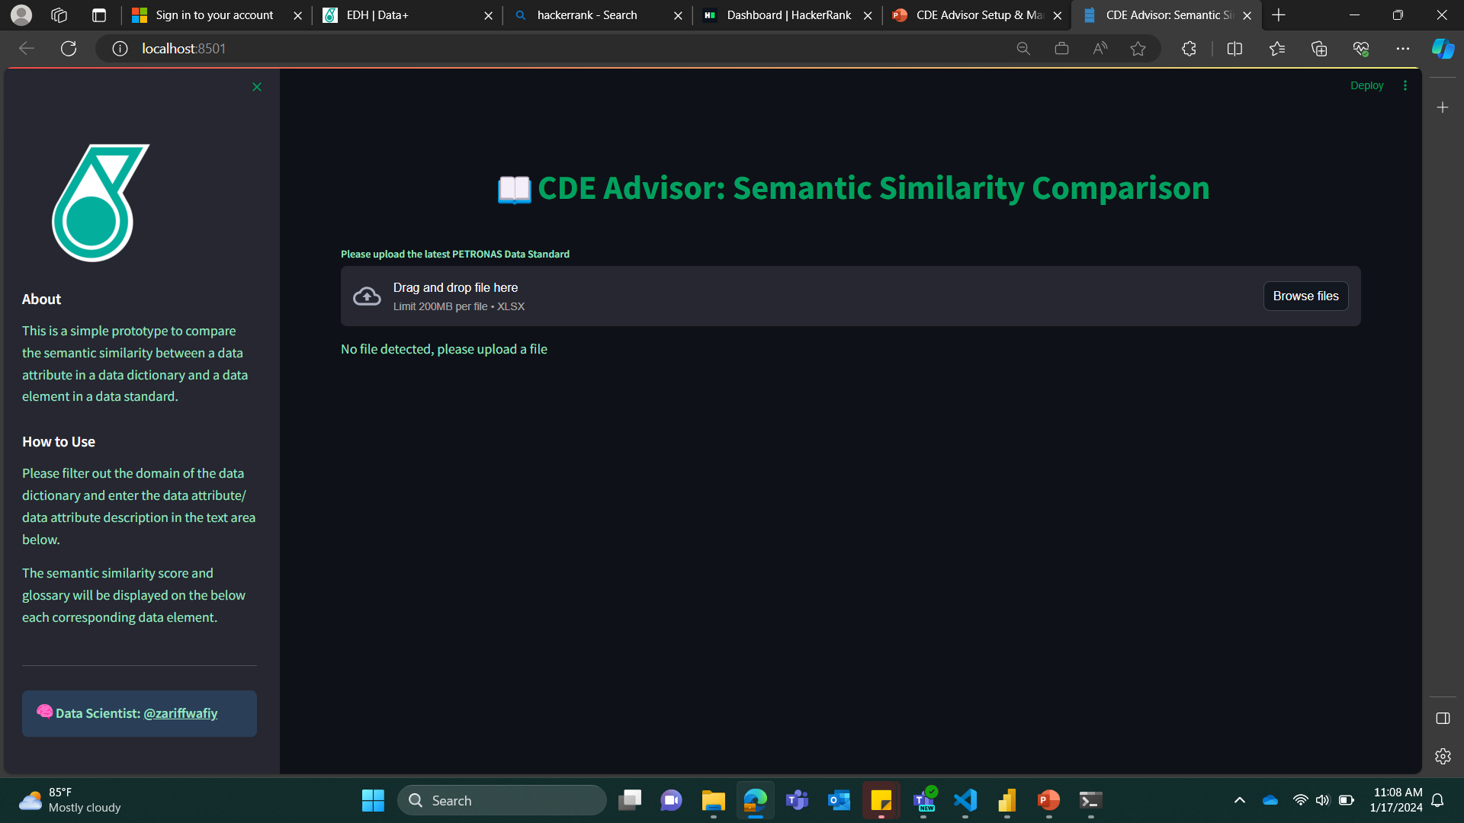
CDE Advisor Manual
Step 1: Upload Latest Data Standard
Click the browse files button and choose the suitable Data Standard.
* At the time of development, the current Data Standard is PETRONAS Data Standard - All - July 2023, user can find the document in the data folder.

Slide 11
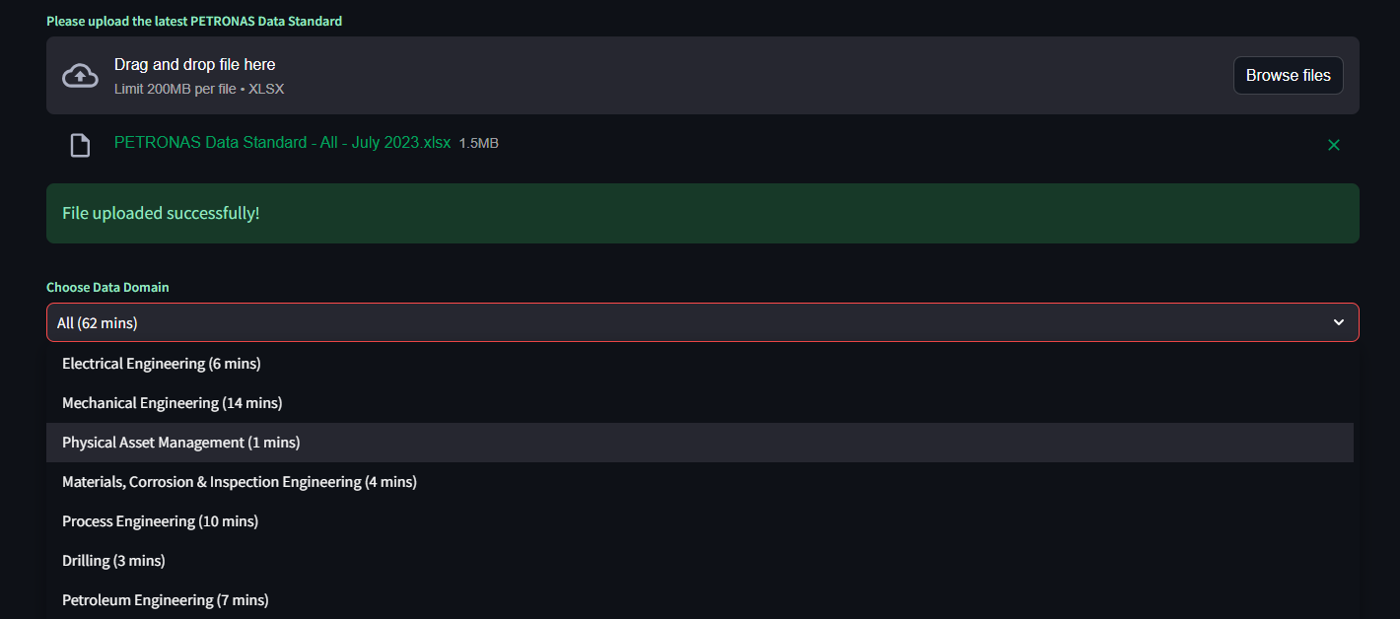
CDE Advisor Manual
Step 2: Choose Data Domain
Choose from the dropdown menu the domain that is concerning the data dictionary.

Slide 12
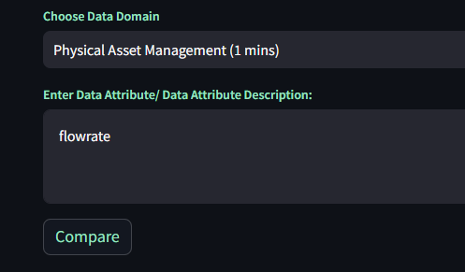

CDE Advisor Manual
Step 3: Enter Data Attribute/ Data Attribute Description:
Enter the Data Attribute/
Data Attribute Description.
2. Click the ‘Compare’ button.
The Data Attribute/ Data Attribute Description should be taken from a Data Dictionary.
3. Click the ‘Stop’ button to interrupt the program.

Slide 13
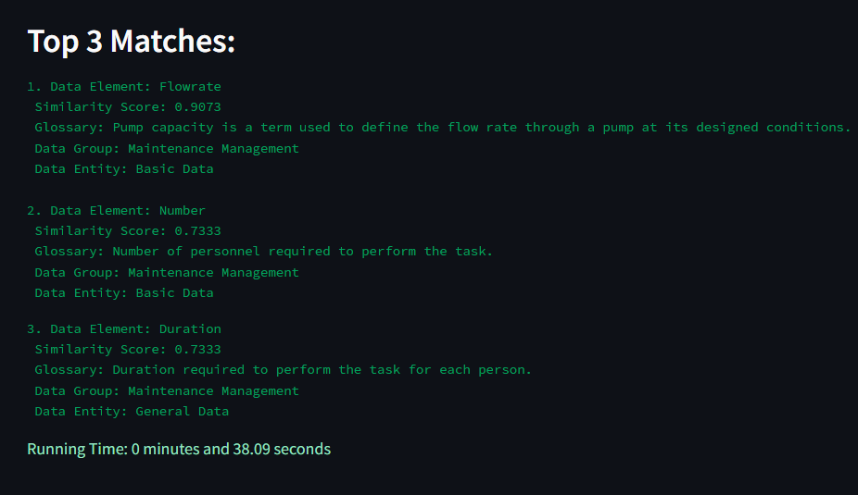
CDE Advisor Manual
Step 4: Validate output
Analyst should validate the top 3 matches of data element by:
1. Referring to the data standard
2. Have a session with SME
then only fill-in CDE in the Data Dictionary accordingly.

